Slide 1
NetRipper
Smart traffic sniffing for penetration testers
Ionut Popescu – Senior Security Consultant @ KPMG Romania

Slide 2


Who am I?
Ionut Popescu
Senior Security Consultant @ KPMG Romania
Blogger @ securitycafe.ro
Administrator @ rstforums.com

Slide 3



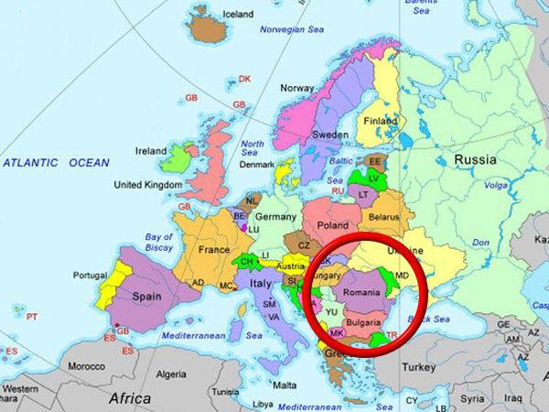

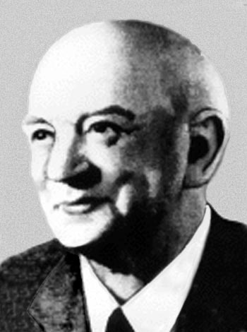
Romania
High speed Internet

Slide 4

Agenda
Introduction
How it works
Reflective DLL Injection
API Hooking
Hooking examples
Demo
Questions?

Slide 5
Introduction
NetRipper is a post exploitation tool targeting Windows systems which uses API hooking in order to intercept network traffic and encryption related functions from a low privileged user, being able to capture both plain-text traffic and encrypted traffic before encryption/after decryption.

Slide 6



When it is useful
Internal penetration test
User
NetRipper
Pentester
Sysadmin
User

Slide 7
How it works - Example
Outlook
Hi,
The new password is “Defcon23”.
Thanks!
User
Encryption layer
NetRipper
… encrypted data…
(╯°□°）╯︵ ┻━┻
… encrypted data…
Network

Slide 8
How it works - Example
Outlook
Hi,
The new password is “Defcon23”.
Thanks!
User
Encryption layer
ncrypt.dll
(SslEncryptPacket)
… encrypted data…
(╯°□°）╯︵ ┻━┻
… encrypted data…
ws2_32.dll
(send/WSASend)

Slide 9
How it works - Example
Outlook
Hi,
The new password is “Defcon23”.
Thanks!
User
Encryption layer
ncrypt.dll
(SslEncryptPacket)
NetRipper.dll
(Hook)
… encrypted data…
(╯°□°）╯︵ ┻━┻
… encrypted data…
ws2_32.dll
(send/WSASend)

Slide 10
Implementation details
Reflective DLL Injection
The DLL is injected into target processes
API Hooking
Specific functions are intercepted
Data extraction
Unencrypted data is saved locally

Slide 11
Classic DLL Injection
How it works:
Open the remote process
Write DLL full path location in process memory
Call LoadLibrary() to load the DLL
Disadvantages:
DLL must be written on disk
DLL is listed in the process modules

Slide 12
Reflective DLL Injection Stephen Fewer [Harmony Security]
How it works:
DLL contents are copied from memory to target process memory
An exported function is called ( ReflectiveLoader() )
The function correctly loads the DLL into memory
Advantages:
DLL does not touch the disk (antivirus bypass)
DLL is not listed in the process modules (stealth)

Slide 13
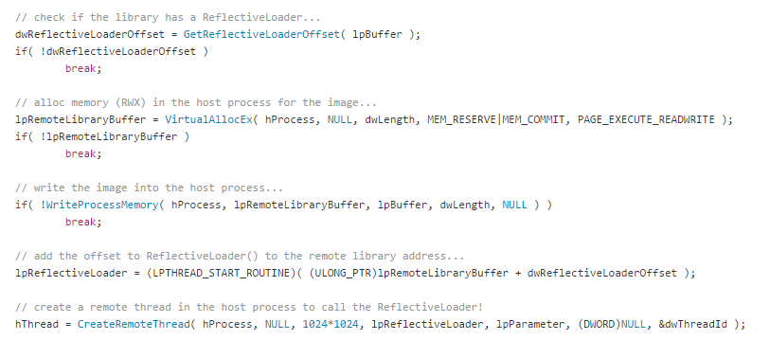

Detailed Reflective DLL Injection [1]
Load the DLL contents into remote process:

Slide 14
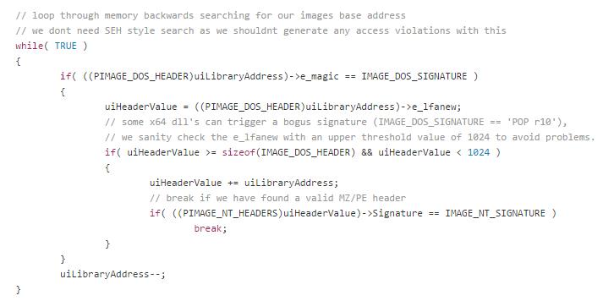

Detailed Reflective DLL Injection [2.1]
Find the DLL image base (like LoadLibrary):

Slide 15
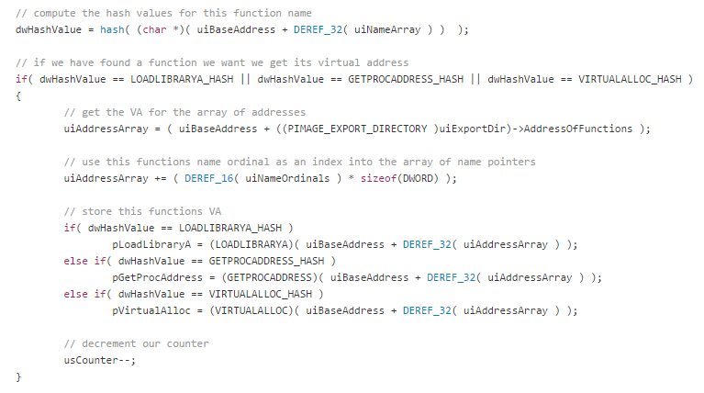

Detailed Reflective DLL Injection [2.2]
Find useful functions:
LoadLibraryA, GetProcAddress, VirtualAlloc, NtFlushInstructionCache

Slide 16
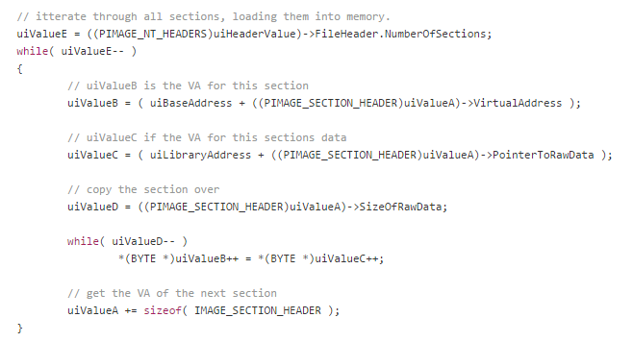

Detailed Reflective DLL Injection [2.3]
Load DLL headers and sections:

Slide 17

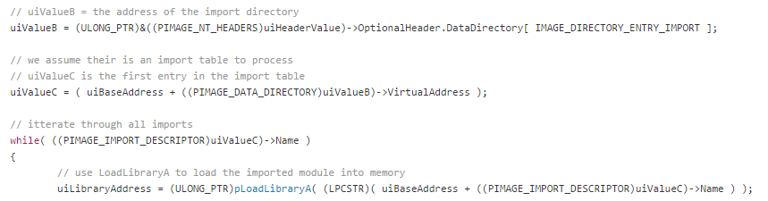
Detailed Reflective DLL Injection [2.4]
Process imports and load additional DLLs:

Slide 18

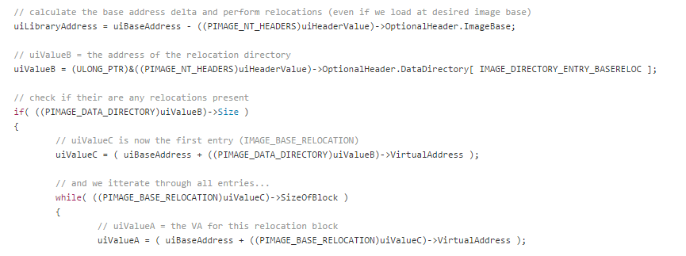
Detailed Reflective DLL Injection [2.5]
Process image relocations:

Slide 19
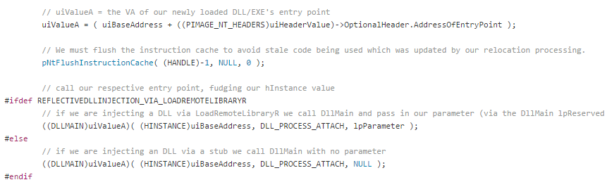

Detailed Reflective DLL Injection [2.6]
Call entrypoint (DllMain):

Slide 20
API Hooking
Outlook.exe
user32.dll
ncrypt.dll
…
SslEncryptPacket
SslDecryptPacket
…
NetRipper.dll
…
SslEncryptPacket_Hook
SslDecryptPacket_Hook
…
ws2_32.dll

Slide 21

API Hooking
Find function address
Place a “call” instruction
Call a generic hook function instead
Restore original bytes
Call a callback function
Call original function
Save network traffic data
Restore hook

Slide 22
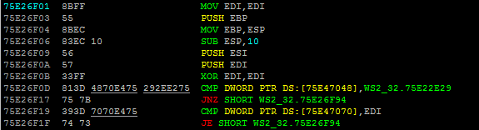
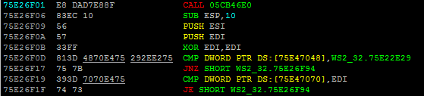
API Hooking
Normal function code:
Hooked function code:

Slide 23
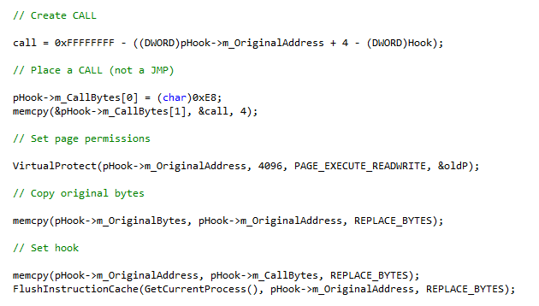

API Hooking details
Place hook:

Slide 24
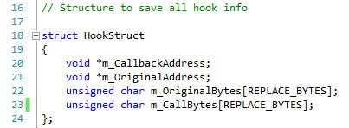
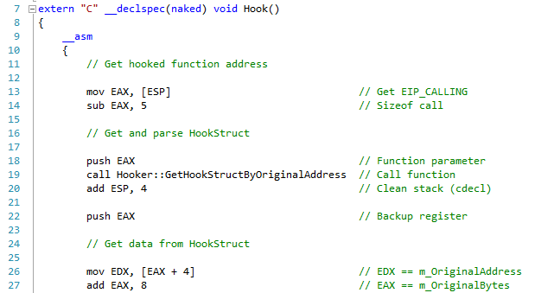

API Hooking details
Get hook information:

Slide 25
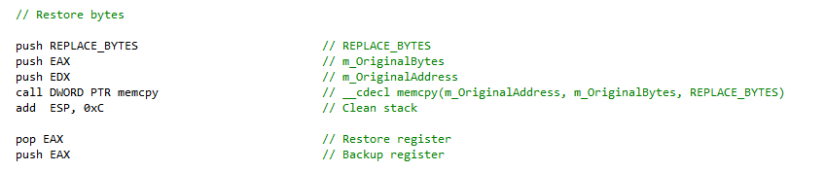
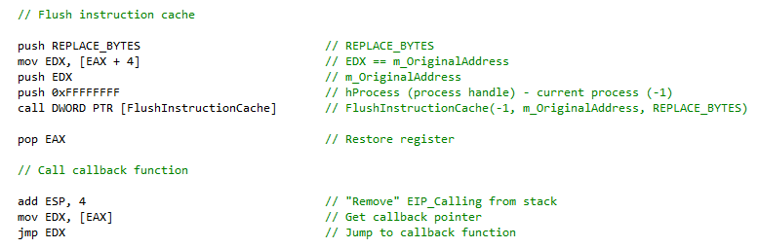

API Hooking details
Place hook:

Slide 26
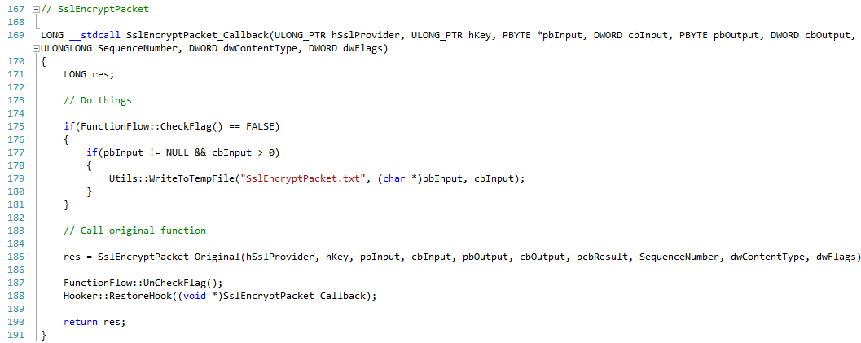

API Hooking details
Callback function:

Slide 27
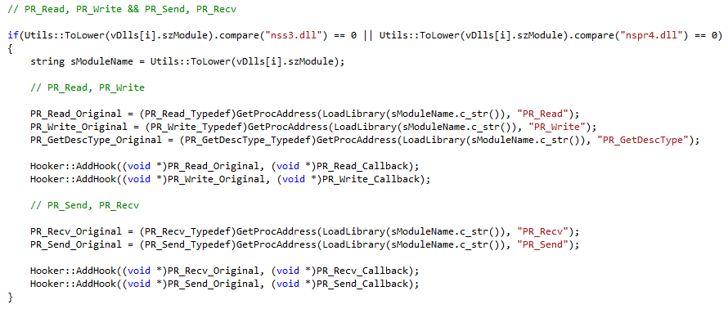
Hooking Mozilla Firefox

Slide 28
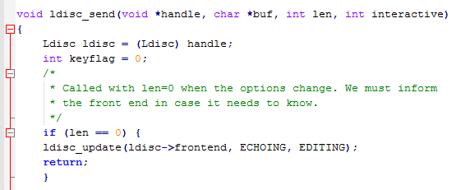
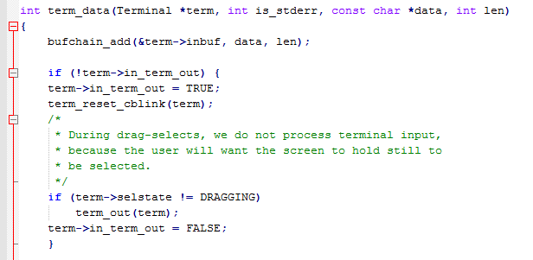
Hooking Putty
PuttyRider – Adrian Furtuna, KPMG Romania
Hijack Putty sessions in order to sniff conversation and inject Linux commands
https://github.com/seastorm/PuttyRider

Slide 29
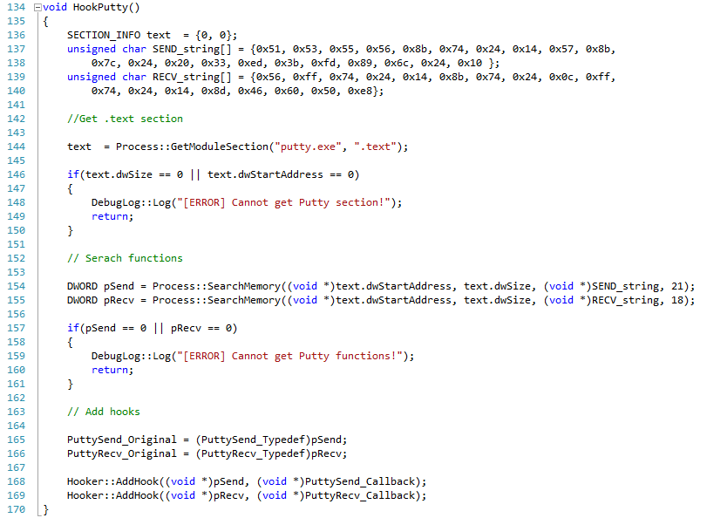
Hooking Putty

Slide 30
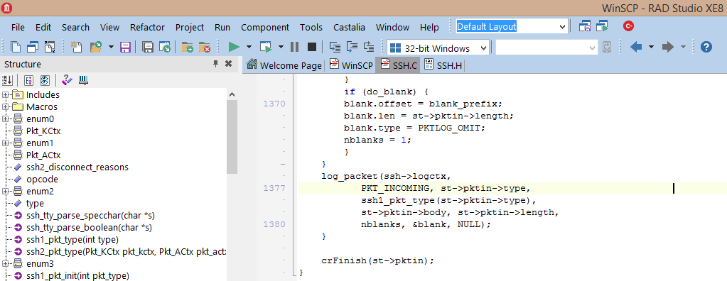
Hooking WinSCP
Find send/recv, asm { int 0x3 }, compile, run

Slide 31
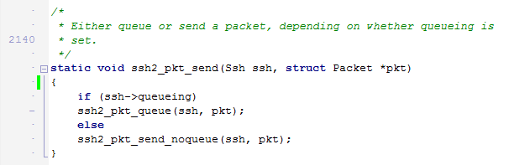
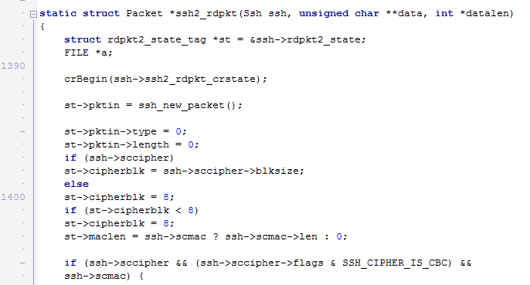
Hooking WinSCP
Check the contents of the *Packet* structure!

Slide 32
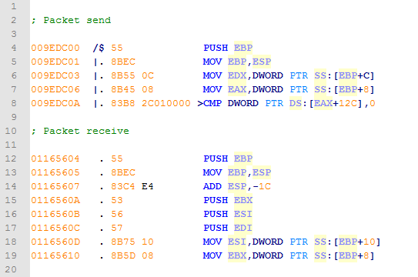
Hooking WinSCP

Slide 33
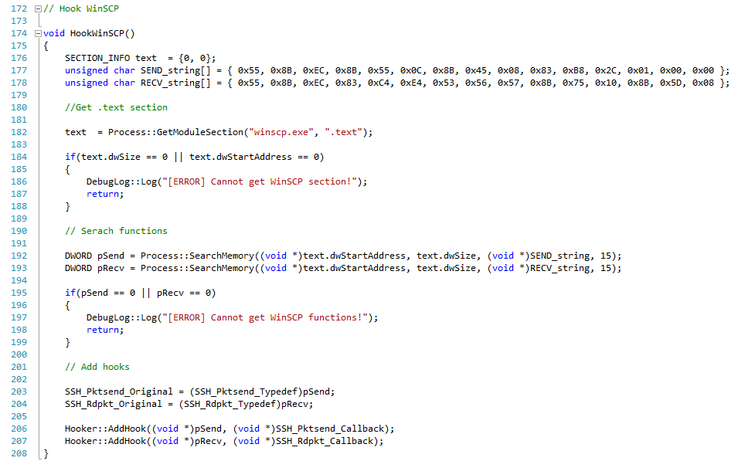
Hooking WinSCP

Slide 34
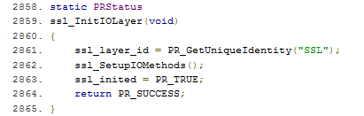
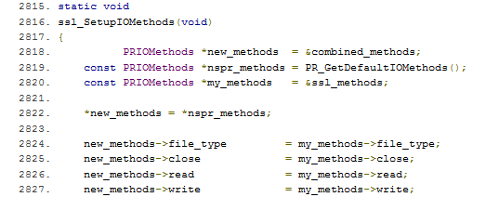
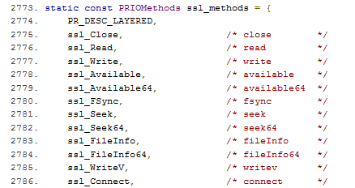
Hooking Chrome NSS
/net/third_party/nss/ssl/sslsock.c

Slide 35
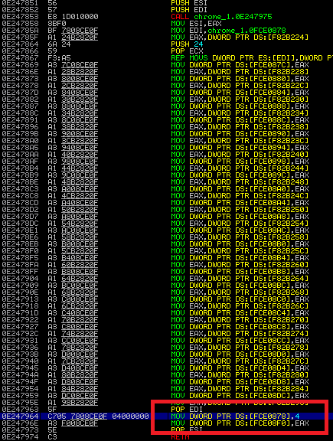
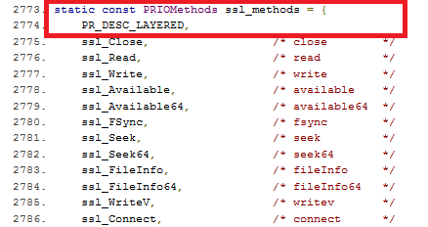
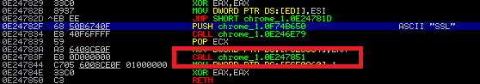
Hooking Chrome NSS

Slide 36
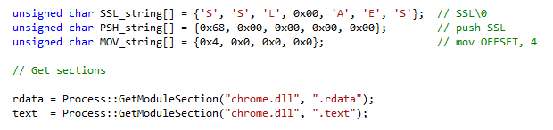
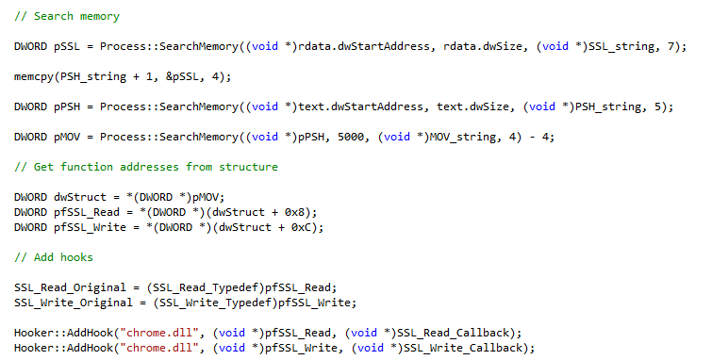
Hooking Chrome NSS
Initialization data
Find SSL string
Find push SSL
Find MOV [x], 4
Get pointers

Slide 37
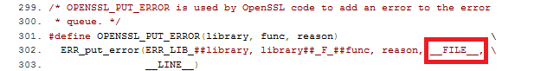
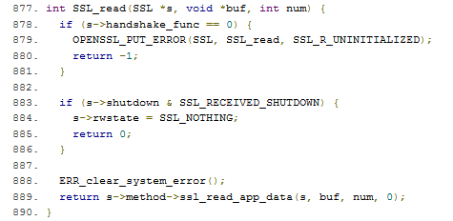
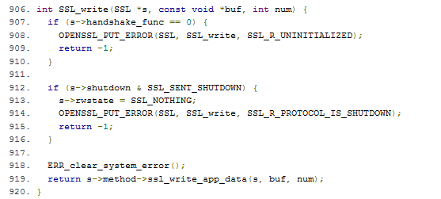
Hooking Chrome BoringSSL
Filename is included in binary.
/ssl/ssl_lib.c

Slide 38
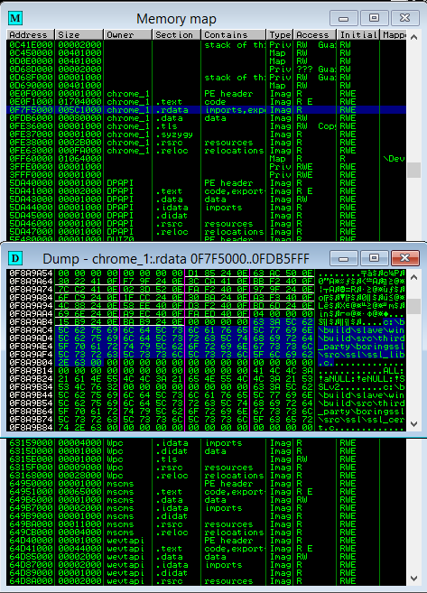
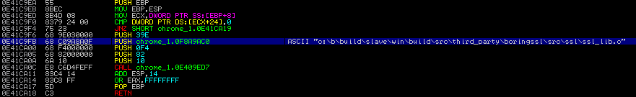
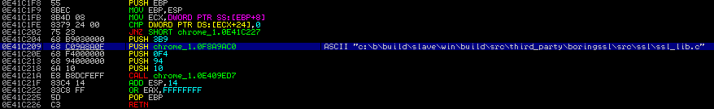
Hooking Chrome BoringSSL
Find 15th and 17th occurrence.

Slide 39
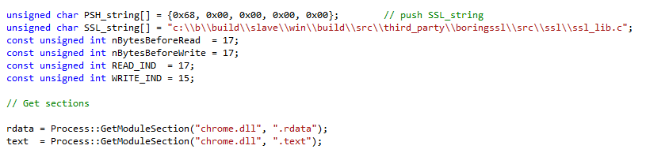
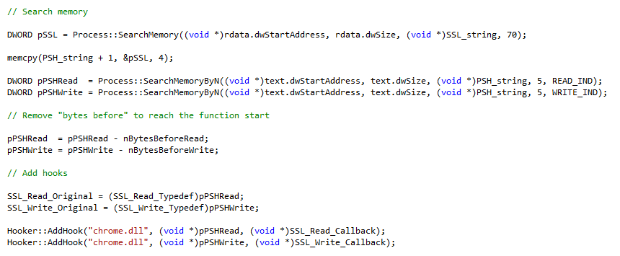
Hooking Chrome BoringSSL
Initialization
Search string
Search PUSH
Find 15th PUSH
Find 17th PUSH
Go back 17 bytes

Slide 40
Plugins
Process data sent and received in order to extract the most useful information.
Default plugins:
PlainText – true/false
DataLimit – 4096
StringFinder – user,pass,login

Slide 41
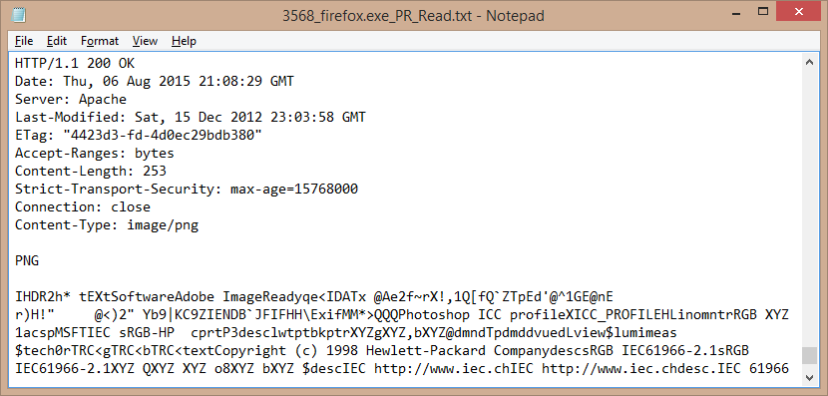
PlainText

Slide 42
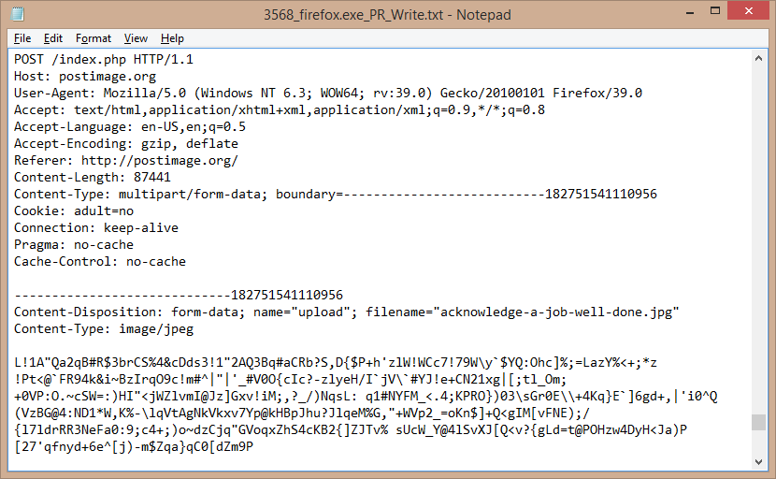
DataLimit

Slide 43
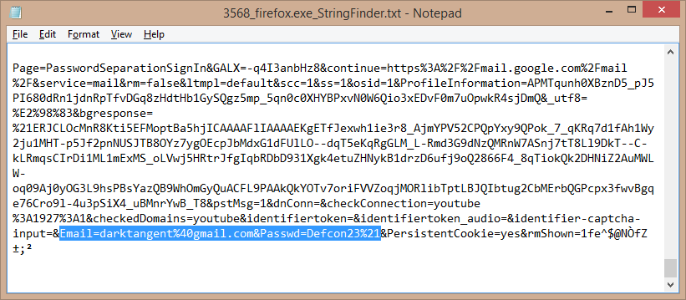
StringFinder

Slide 44
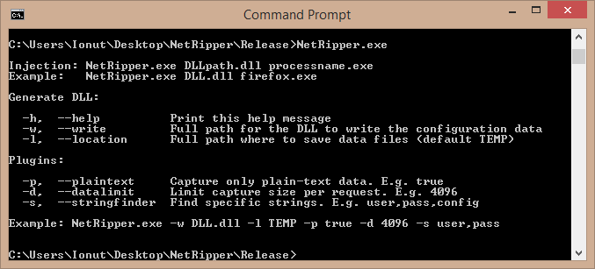
Windows module
C:\Users\Ionut\Desktop\NetRipper\Release>NetRipper.exe DLL.dll firefox.exe
Trying to inject DLL.dll in firefox.exe
Reflective injected in: 9960

Slide 45
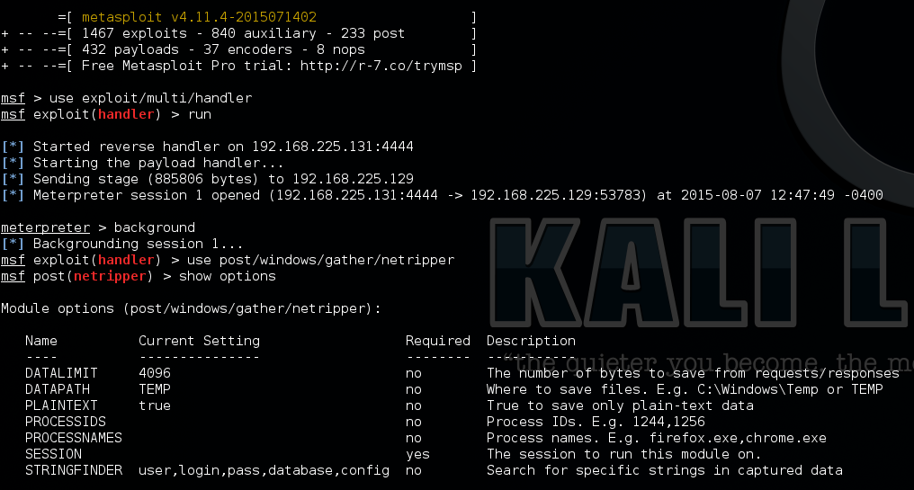
Metasploit module

Slide 46


DEMO
Meterpreter
Penetration tester
(virtual machine)
Administrator
(virtual machine)

Slide 47
Future work
x64 processes
Multiple software
Older versions
Thread safety
Regular expressions plugin

Slide 48
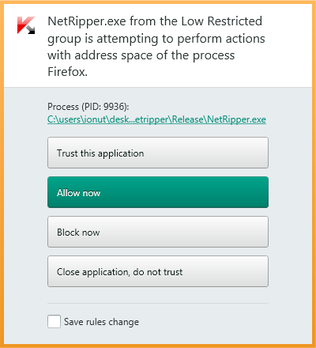
Defense
Dear Microsoft,
On a Windows system, a low privileged process should not be able to access or modify the memory space of other process.
Thank you!
Note: There are at least 10 methods to inject a DLL.

Slide 49
Project information
https://github.com/NytroRST/NetRipper/

Slide 50
Conclusion
Post exploitation tool
Uses Reflective DLL Injection and API Hooking
Hooks application-specific functions
Captures network traffic in plain-text
Easy to use

Slide 51

Questions?

Slide 52


Contact information
ionut.popescu [@] outlook.com
contact [@] securitycafe.ro
@NytroRST

